Slide 1
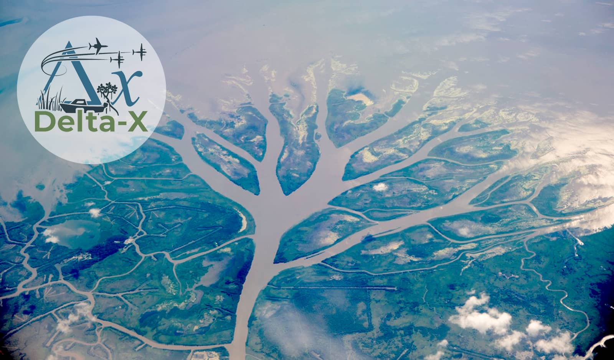

Delta-X Open Data Workshop: Airborne Visible/Infrared Imaging Spectrometer—Next Generation (AVIRIS-NG)
Daniel Jensen
Postdoctoral Researcher, PI: Marc Simard
Jet Propulsion Laboratory, California Institute of Technology
May 4, 2022

Slide 2
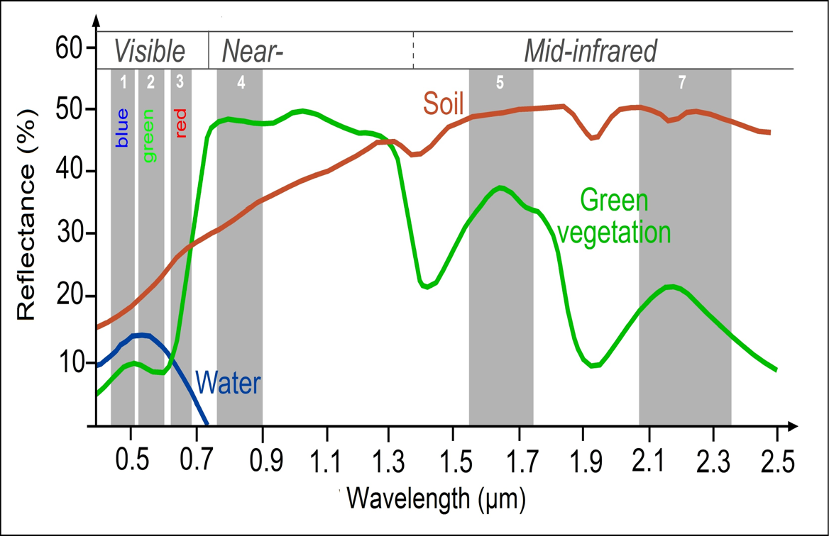
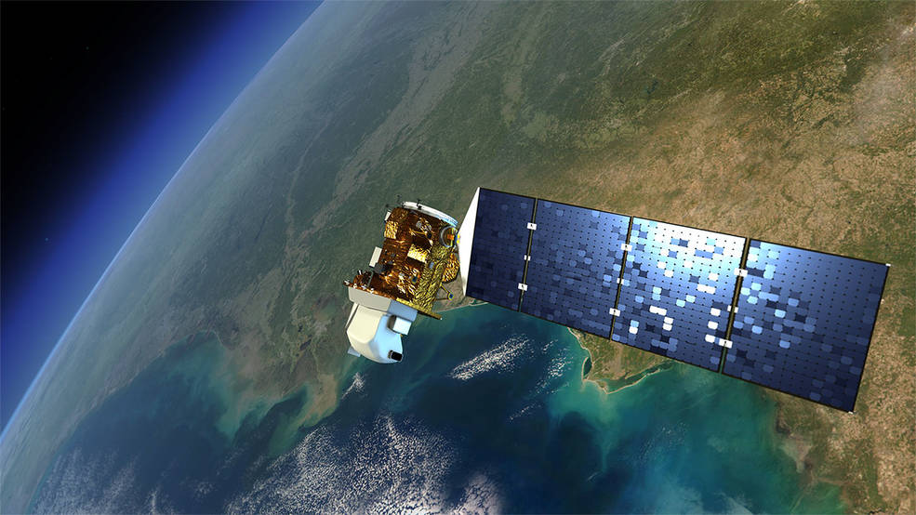
Using Remote Sensing Data for Wetland Applications
Optical remote sensing allows us to examine landscape-scale distributions and processes in wetlands
E.g. vegetation type and health, land changes, water quality
Multispectral satellite instruments
(e.g. Landsat, MODIS)
Measure radiance/reflectance in several bands
(https://seos-project.eu/classification/classification-c01-p05.html)
(https://www.nasa.gov/mission_pages/landsat/overview/index.html)

Slide 3
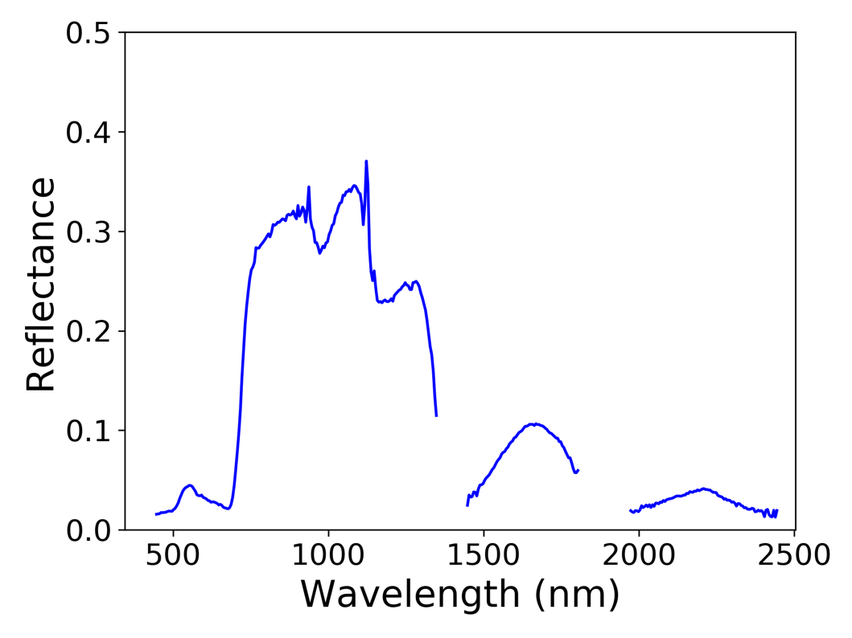
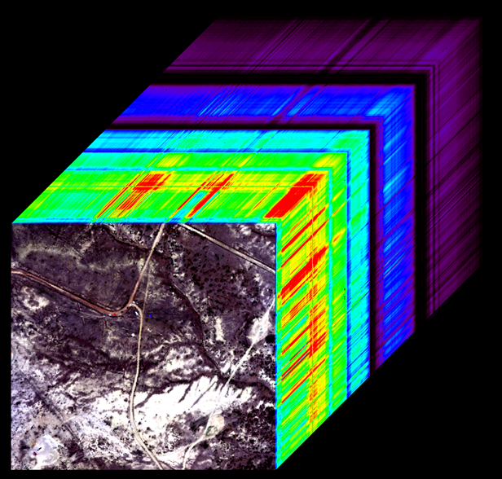
Using Remote Sensing Data for Wetland Applications
What is imaging spectroscopy/hyperspectral data?
Continuous radiance measurements → surface reflectance
”Image Cube” approximating VSWIR reflectance properties per pixel
Spectral characteristics associated with plant structural and biochemical properties
Unique spectral signatures enable land cover/vegetation mapping
Future NASA mission: Surface Biology and Geology
(https://aviris-ng.jpl.nasa.gov/science.html)

Slide 4
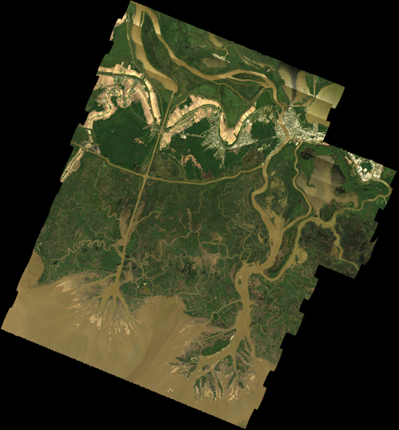
AVIRIS-NG Data Characteristics
Wavelengths: ~380 – 2500 nm
~5 nm sampling
425 bands
~5 m spatial resolution
3 airborne campaigns conducted 2021:
April, August, September (Post-Ida)
Spatially/spectrally complex region

Slide 5
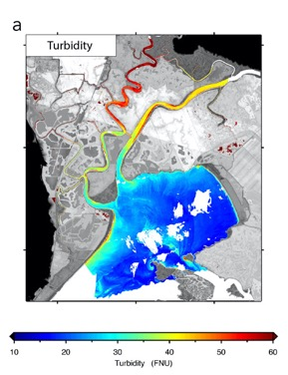
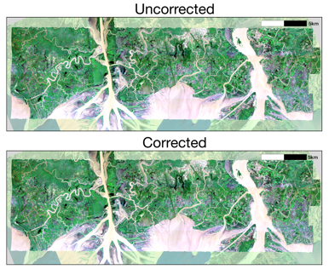
Airborne Visible/Infrared Imaging Spectrometer–Next Generation (L1-L3)
1 km
N
(Image courtesy of David Thompson & Evan Greenberg)
Surface Reflectance
(HRDF)
Radiance at sensor
BRDF and glint correction
Vegetation and water sediment maps
Radiance products use May 2021 hangar calibration data (Chapman et al. 2019) and atmospheric features for in-flight wavelength calibration adjustments (Thompson et al. 2015)
Atmospheric correction is the EMIT mission approach of Optimal Estimation (Thompson et al. 2018, 2019) with speed enhancements (Thompson et al. 2020)
BRDF correction via FlexBRDF (Queally et al., 2022) and simultaneous sunglint correction (Greenberg et al. 2022)

Slide 6
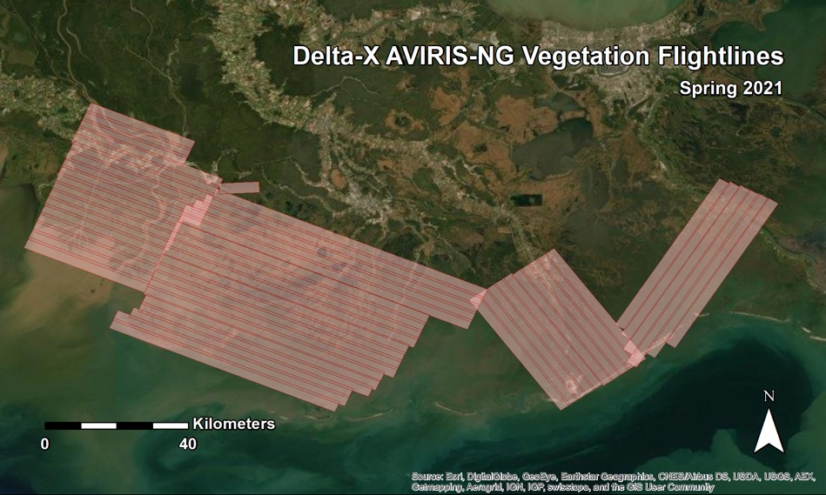
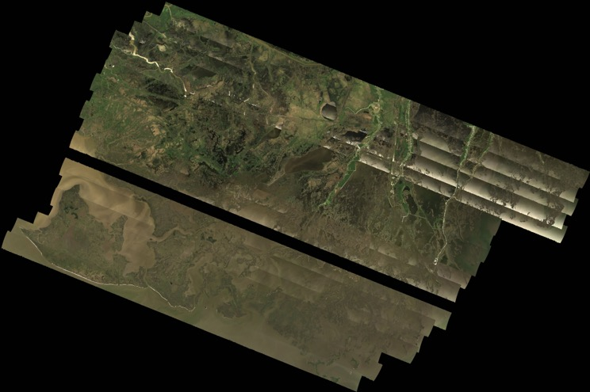
Delta-X AVIRIS-NG Data Products
Spring, Fall, Post-Ida Deployments: 144 Terrestrial Vegetation flightlines, 44 Water Quality flightlines
L1
Radiance at Sensor flightlines
L2
Surface Reflectance flightlines
L2B
BRDF and Glint-Corrected flightlines
BRDF and Glint-Corrected mosaics
L3
Vegetation Type and Biomass Maps
Water Quality (Suspended Sediment Concentration)
Hosted by ORNL DAAC
DAAC Home > Get Data > NASA Projects > Delta-X
daac.ornl.gov/cgi-bin/dataset_lister.pl?p=41

Slide 7
AVIRIS-NG Workshop Outline
Module 1: AVIRIS-NG Data Introduction
Open data
Visualize/Export bands
Plot spectra
Module 2: Normalized Difference Vegetation Index
Compute NDVI
Plot NDVI histogram
Generate land/water mask
Module 3: Principal Components Analysis
Perform PCA dimension reduction on image
Plot explained variance and visualize component bands
Module 4: Classification
K-means unsupervised classification on PCA results
Create preliminary landcover map
Module 5: Partial Least Squares Regression and Water Quality
Generate and apply a suspended sediment concentration model
https://github.com/djjensen/DeltaX_Applications_Workshop_AVIRIS-NG

Slide 8
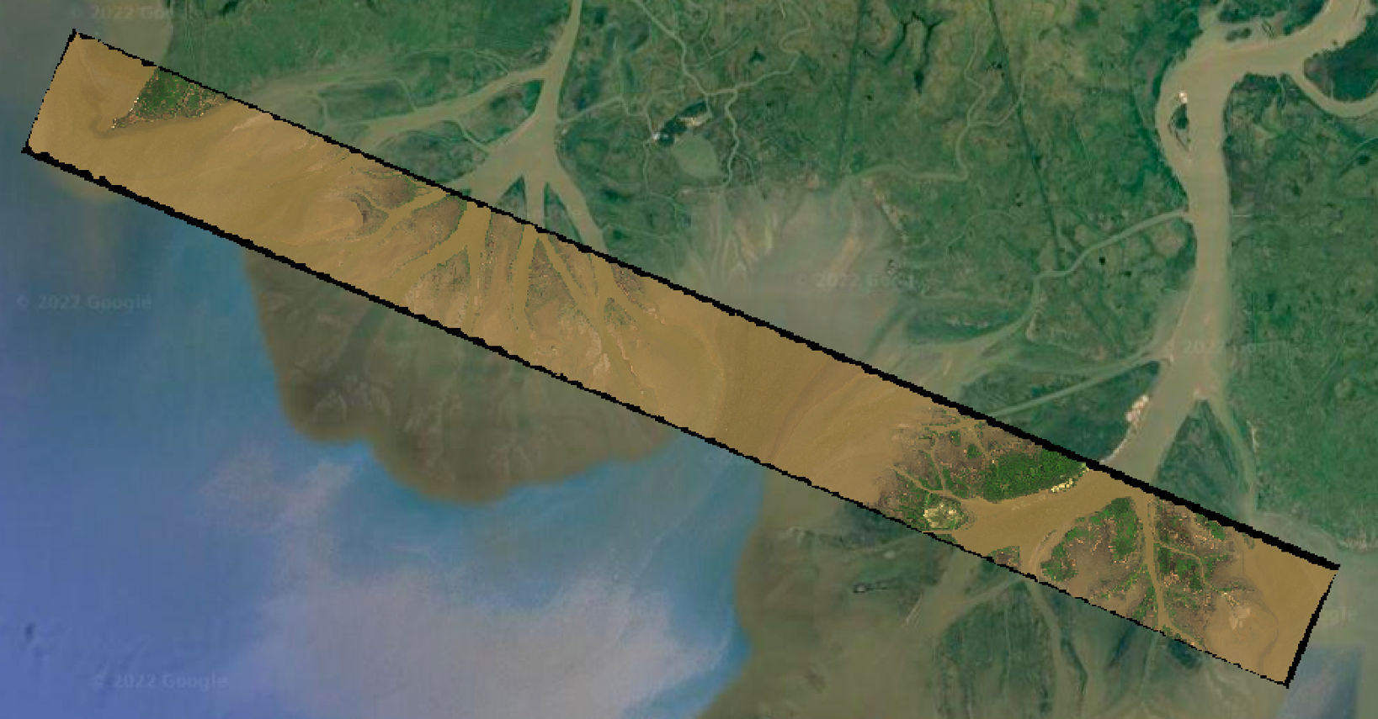
Module 1: AVIRIS-NG Data Introduction
Objectives:
Open and explore an AVIRIS-NG L2 surface reflectance image
Visualize bands and plot pixel spectra
Export RGB true color composite
https://github.com/djjensen/DeltaX_Applications_Workshop_AVIRIS-NG

Slide 9
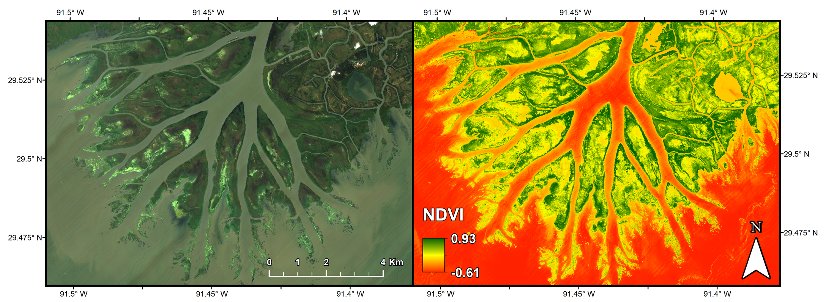
Module 2: Normalized Difference Vegetation Index
Objectives:
Calculate an NDVI image
Plot histogram of NDVI values
Generate a land/water mask for the image

Slide 10
Normalized Difference Vegetation Index (NDVI):
Index to estimate net primary production/photosynthetic activity
Applications include:
monitoring vegetation phenology
assessing growing season length
general plant health
(https://seos-project.eu/classification/classification-c01-p05.html)

Slide 11
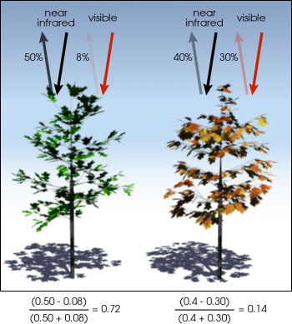
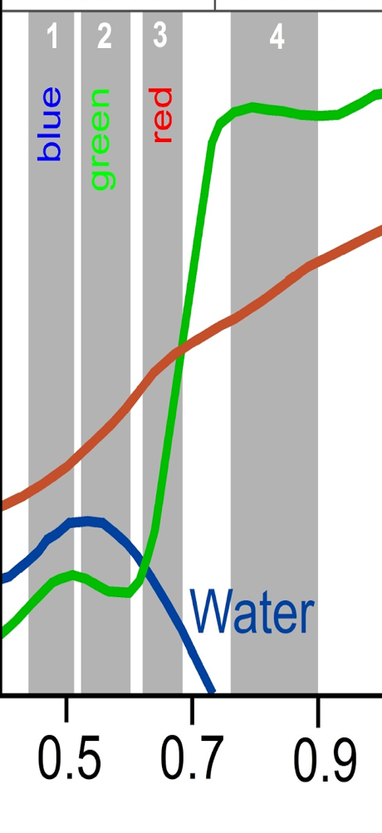
Red Edge (~ 690-730 nm)
Low vegetation reflectance in the red region followed by a sharp increase to the high reflectance in the near-infrared Measure of “greenness” of a pixel
NDVI Range of -1 to 1
Brighter pixel = more green, i.e. the greater the amount of photosynthesizing (“healthy”) vegetation present
(https://seos-project.eu/classification/classification-c01-p05.html)
(http://earthobservatory.nasa.gov/Features/MeasuringVegetation/)

Slide 12
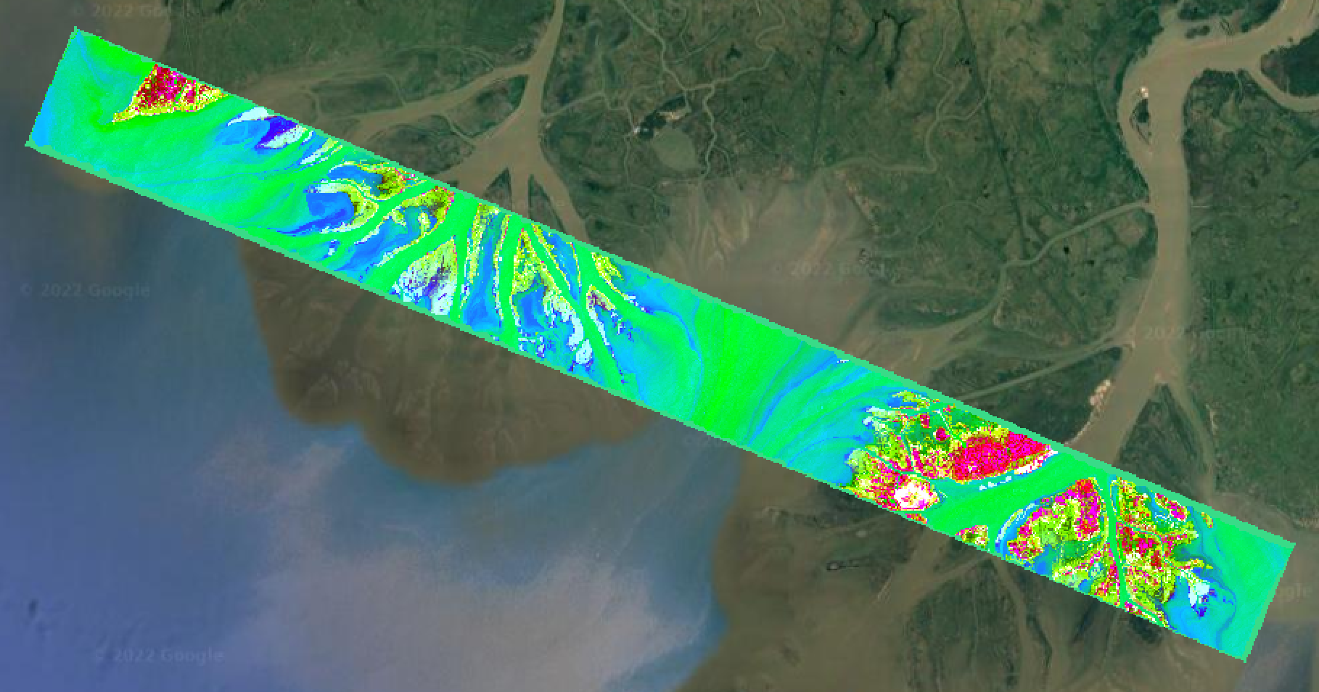
Module 3: Principal Components Analysis
Objectives:
Perform PCA dimension reduction on image
Plot explained variance
Visualize component bands
Export output selection

Slide 13
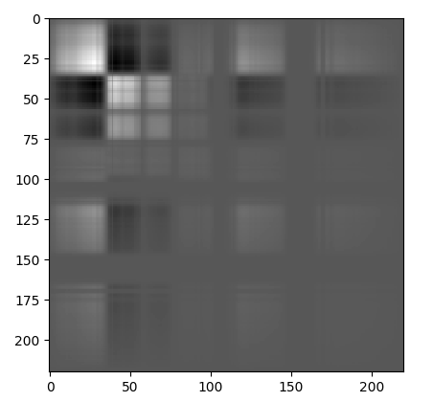
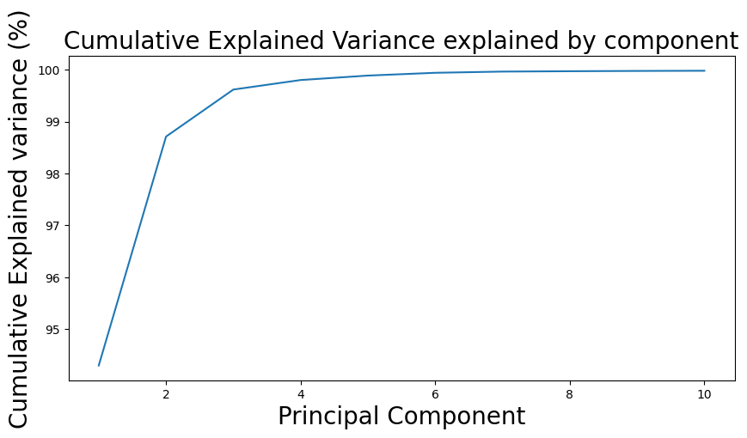
Principal Components Analysis
PCA is a linear dimensionality reduction technique
Well suited for high-dimensionality (i.e. 425 bands) imaging spectrometer data
A principal component is a projection of the original data that captures the variance inherent in the original data
First component always captures the most variance
Components are uncorrelated (correlated features in original data contribute to the same principal component)
(https://www.spectralpython.net/algorithms.html)

Slide 14
PCA for imaging spectrometer data like AVIRIS-NG:
Reduce correlated bands while explaining vast majority of variance in image
Capture surface properties
Enable efficient and improved classification
(Jensen et al. 2020)

Slide 15
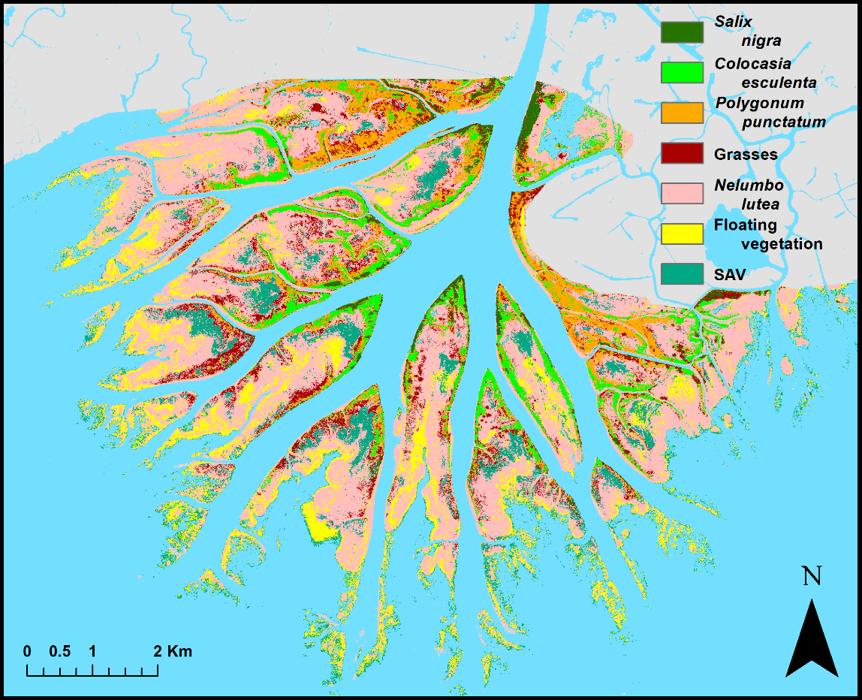
Module 4: Classification
Objectives:
Perform an unsupervised K-Means classification on the PCA output
Generate a preliminary landcover classification of the image
(Jensen et al. 2020)

Slide 16

Unsupervised Classification
Generate given number of clusters from input bands
Band selection
Additional data sources
E.g. Digital Elevation Model
Principal Components Analysis
Assign classes from cluster output
Most common algorithms: ISODATA, K-means
(https://seos-project.eu/classification/classification-c01-p05.html)

Slide 17
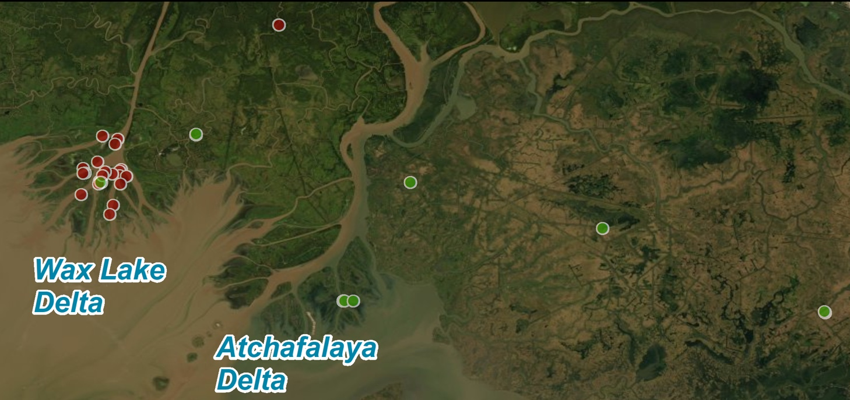
Supervised Classification
Create a training dataset/spectral library
Select training areas corresponding to remote sensing data to generate spectral signatures
OR compile spectral library from known sources
Classify image based on input signatures
Example algorithms:
Maximum Likelihood, Minimum Distance, Spectral Angle Mapper
Machine Learning: Random Forests, Support Vector Machines
(Jensen et al. 2019a)

Slide 18
Module 5: Partial Least Squares Regression and Water Quality
Objectives:
Use in situ water sample and reflectance data to generate a suspended sediment concentration model
Create a map of estimated Total Suspended Solids (mg/L)
(Jensen et al. 2019b)

Slide 19
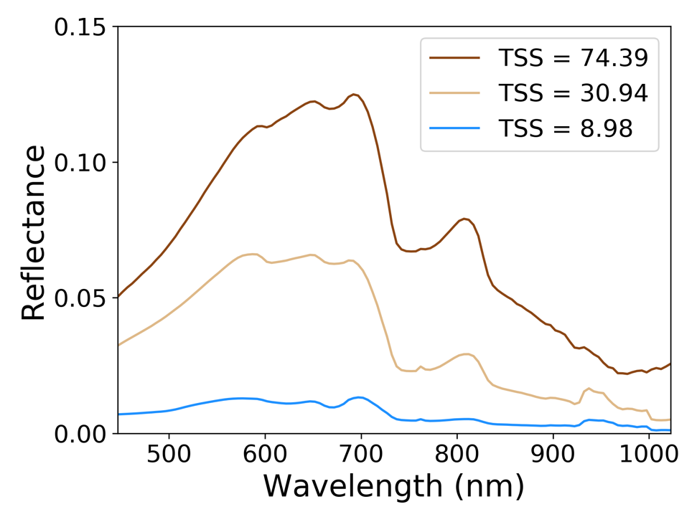
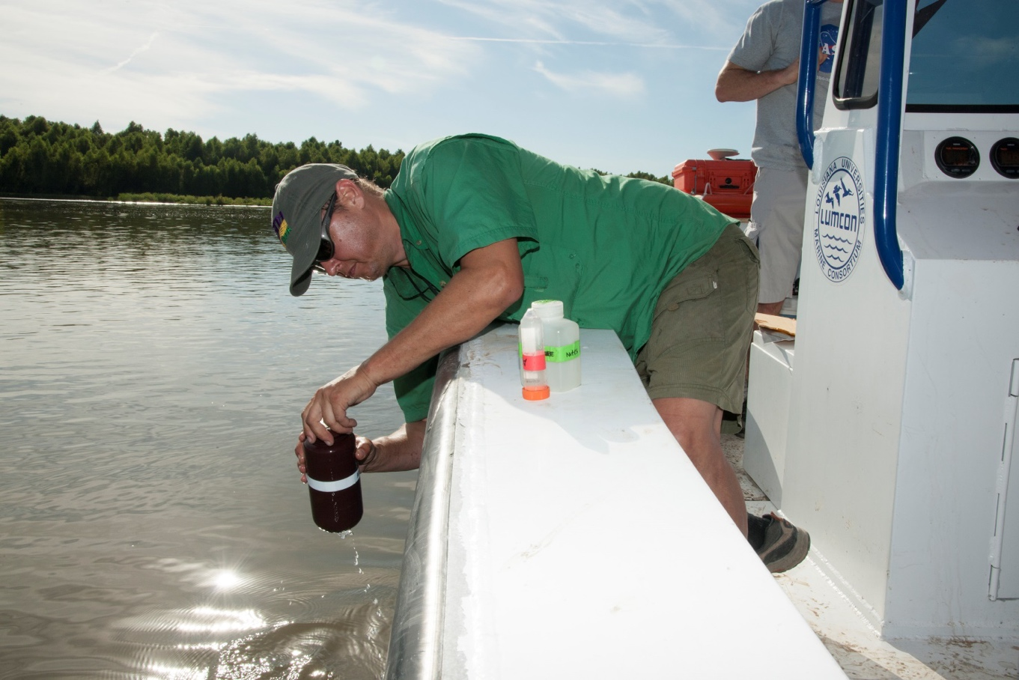
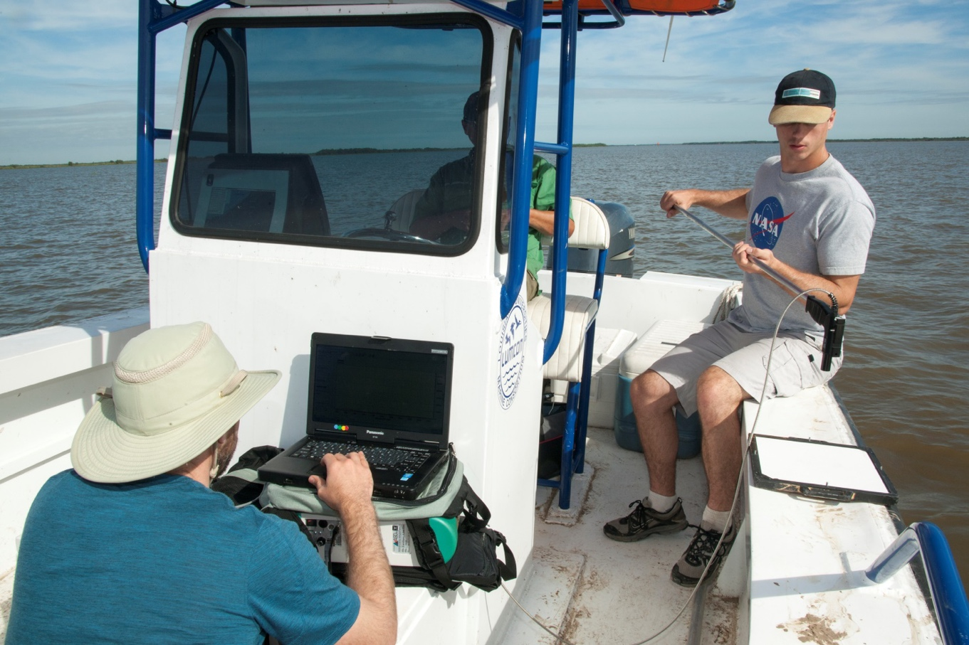
Field Data (October 2016)
Water samples
Total Suspended Solids (mg/L)
ASD Field Spectrometer
35 samples

Slide 20
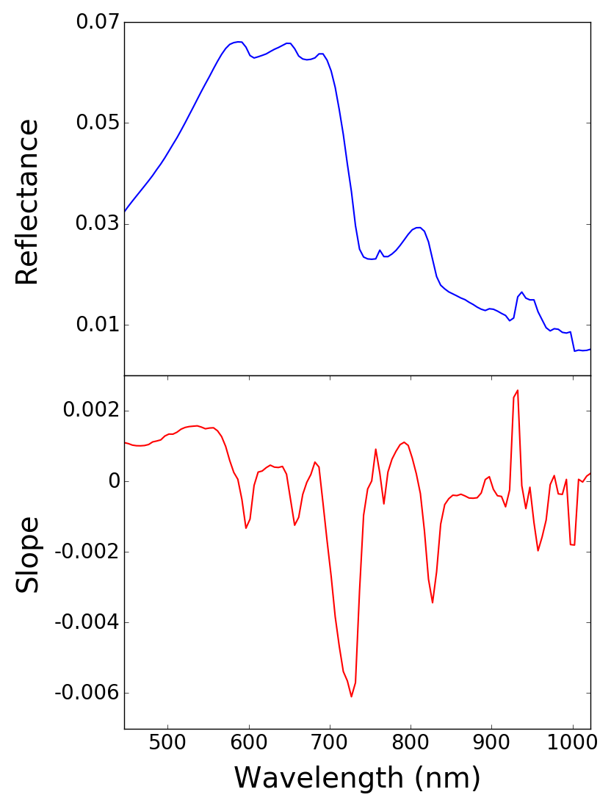
Imaging Spectroscopy and Regression for TSS
Ordinary Least Squares Regression
Predictor variables independent/ not collinear
Large sample size
Partial Least Squares Regression ideal for constructing predictive models with many collinear factors
Reflectance vs. Derivatives
Less sensitive to intensity differences
Sensitive to absorption features and spectral shape

Slide 21

Acknowledgements
Delta-X, Jet Propulsion Laboratory, California Institute of Technology
(deltax.jpl.nasa.gov)
Oak Ridge National Laboratory Distributed Active Archive Center
(https://daac.ornl.gov/cgi-bin/dataset_lister.pl?p=41)
© 2022 California Institute of Technology. Government sponsorship acknowledged.
References
Chapman, John W., David R. Thompson, Mark C. Helmlinger, Brian D. Bue, Robert O. Green, Michael L. Eastwood, Sven Geier, Winston Olson-Duvall, and Sarah R. Lundeen. "Spectral and radiometric calibration of the next generation airborne visible infrared spectrometer (AVIRIS-NG)." Remote Sensing 11, no. 18 (2019): 2129.
Greenberg, E., D. R. Thompson, D. J. Jensen, P. A. Townsend, N. Queally, A. Chlus, C. G. Fichot, J. Harringmeyer, and Marc Simard. "An improved scheme for correcting remote spectral surface reflectance simultaneously for terrestrial BRDF and water‐surface sunglint in coastal environments." Journal of Geophysical Research: Biogeosciences.
Jensen, D., Cavanaugh, K. C., Simard, M., Okin, G. S., Castañeda-Moya, E., McCall, A., & Twilley, R. R. (2019a). Integrating Imaging Spectrometer and Synthetic Aperture Radar Data for Estimating Wetland Vegetation Aboveground Biomass in Coastal Louisiana. Remote Sensing, 11(21), 2533. https://doi.org/10.3390/rs11212533
Jensen, D., Simard, M., Cavanaugh, K., Sheng, Y., Fichot, C. G., Pavelsky, T., & Twilley, R. (2019b). Improving the Transferability of Suspended Solid Estimation in Wetland and Deltaic Waters with an Empirical Hyperspectral Approach. Remote Sensing, 11(13), 1629. https://doi.org/10.3390/rs11131629
Jensen, D., Cavanaugh, K. C., Simard, M., Christensen, A., Rovai, A., & Twilley, R. (2020). Aboveground biomass distributions and vegetation composition changes in Louisiana’s Wax Lake Delta. Estuarine, Coastal and Shelf Science, 250 (March 2021), 107139. https://doi.org/10.1016/j.ecss.2020.107139
Queally, Natalie, Zhiwei Ye, Ting Zheng, Adam Chlus, Fabian Schneider, Ryan P. Pavlick, and Philip A. Townsend. "FlexBRDF: A flexible BRDF correction for grouped processing of airborne imaging spectroscopy flightlines." Journal of Geophysical Research: Biogeosciences 127, no. 1 (2022).
Thompson, D.R., Leifer, I., Bovensmann, H., Eastwood, M., Fladeland, M., Frankenberg, C., Gerilowski, K., Green, R.O., Kratwurst, S., Krings, T. and Luna, B., 2015. Real-time remote detection and measurement for airborne imaging spectroscopy: a case study with methane. Atmospheric Measurement Techniques, 8(10), pp.4383-4397.
Thompson, D.R., Natraj, V., Green, R.O., Helmlinger, M.C., Gao, B.C. and Eastwood, M.L., 2018. Optimal estimation for imaging spectrometer atmospheric correction. Remote sensing of environment, 216, pp.355-373.
Thompson, D.R., Cawse-Nicholson, K., Erickson, Z., Fichot, C.G., Frankenberg, C., Gao, B.C., Gierach, M.M., Green, R.O., Jensen, D., Natraj, V. and Thompson, A., 2019. A unified approach to estimate land and water reflectances with uncertainties for coastal imaging spectroscopy. Remote Sensing of Environment, 231, p.111198.
Thompson, D.R., Braverman, A., Brodrick, P.G., Candela, A., Carmon, N., Clark, R.N., Connelly, D., Green, R.O., Kokaly, R.F., Li, L. and Mahowald, N., 2020. Quantifying uncertainty for remote spectroscopy of surface composition. Remote Sensing of Environment, 247, p.111898.

